Slide 1
Creating Effective
Marketing Materials

Slide 2
In-Class Activity: Resume Jigsaw
In groups, organize different sections (headings) of a resume – from beginning to end of resume
Remember: there are more headings than needed
Will take up as a group later
Notes:
Instructors: provide cut out sections/heading to groups

Slide 3

Is there a right and wrong way?

Slide 4
What’s in it for them???
Demonstrate what you HAVE to offer the employer NOT what YOU want from the employer
Why should I hire you?

Slide 5
A Good Resume…
Is a glorified application.
This type of resume explains to the hiring manager the following information :
education
dates of employment
companies
titles held
job functions
It is good because the hiring manager can get a clear summation of your past experience and education.

Slide 6
A Great Resume…
Is a marketing brochure.
the scope and depth of your experience
describes the expertise you have developed throughout your career that relates to your future employer's needs
A great resume communicates a compelling reason for the prospective employer to need and want your services.

Slide 7
A Great Resume…
extracts the relevant accomplishments
from your past experiences (education, work, projects, volunteer, etc.)
and highlights them.

Slide 8
It’s not what you know it’s
what you have done
with what you know!!!
Demonstrate where you have applied your knowledge and skills

Slide 9
SELL IT…Don’t Tell it!
TELL IT - Simply states facts
SELL IT – promotes, advertises, draws attention to it, adds impact and value
Don’t be generic – what makes you stand out from the rest
Don’t focus on what you want
Demonstrate skills you have related to the job
A smart resume focuses on relevant skills and qualifications!

Slide 10
CHRONOLOGICAL RESUME
Organized according to time in reverse chronological order
Most recent education/experience first
Focuses on dates and job experiences
Most widely used type of resume
Most suitable for students and recent grads
Notes:
Ask students to look at example resume on page 38

Slide 11
TARGETED RESUME
Relate everything to the position applying for
Relevant program skills
Use industry key words
Demonstrate relevant transferable skills
Resume needs to be tweaked for every position you apply for.

Slide 12
GUIDELINES
Blend of good content and attractive format
Easy to follow & maintain consistency
Attract immediate attention (10 – 15 seconds)
1 – 2 pages in length
DO NOT use complete sentences & lengthy paragraphs
Notes:
Give example of sentence fragment:
Trained new employees in all aspects of office duties

Slide 13
DO USE sentence fragments to express complete thoughts (bullets; point form, no periods)
Use appropriate past and present tense
Never use the word “I” in your resume
Be accurate (do not estimate or guess on details)
Proofread meticulously (Spelling; Grammar; Typos)
One mistake could cost you the job

Slide 14
Jane Doe
1400 London Road, Sarnia, ON N7S 6K4
519 542 7771
jdoe@hotmail.com
Jonathan B. Doe
1400 London Road, Sarnia, ON N7S 6K4 519 542-7771 jdoe@hotmail.com
Jane Doe 519 542-7771
1400 London Road, Sarnia, ON N7S 6K4 jdoe@hotmail.com

Slide 15
HIGHLIGHT OF SKILLS & QUALIFICATIONS
Experience (think: how much, relevant)
Outstanding personal characteristics – related
Technical Skills – program related
Industry related training
Computer skills
Achievements
Languages
Certifications (include provider and date achieved)
Only add if you have 3 or less – or if it’s relevant
WARNING:
BE PREPARED TO BACK UP ANY STATEMENT OR CLAIM YOU MAKE ON YOUR RESUME IN YOUR INTERVIEW!

Slide 16
HIGHLIGHT OF SKILLS & QUALIFICATIONS - GUIDELINES
First statement: states your current situation
Second statement: states # of years (or months) of related experience
Third statement: areas of expertise
Fourth statement: personal attributes important to the role and company
REFER TO JOB POSITION REQUIREMENTS AND DESCRIPTION FOR KEY SKILLS/WORDS
Include 4-8 points!

Slide 17
Example Of A Highlight Section
HIGHLIGHT OF SKILLS & QUALIFICATIONS
Current student in the Occupational Health & Safety Post-Graduate Certificate program at Lambton College
2+ years of experience as a Human Resources Assistant
Excellent communication skills with ability to_______
Proficient in Microsoft Office including, Word, Excel, PowerPoint; experience with_______ software
Skilled at working with people from diverse cultures; multilingual in English, Hindi, French and Spanish
Notes:
*****Instructors: Make relevant to program!

Slide 18
EDUCATION
Reverse Chronological Order
(Most recent first)
Program name in Bold
Make sure you have the proper name of your program!
Note: you are in a Certificate program (not Diploma)
Achievements / Awards
School Name, City, Province
Graduating Date / Expected Graduation Date
Important Courses (optional)
Grade Point Average (optional/only for current program!)

Slide 19
EDUCATION: Example
Occupational Health and Safety – Post Grad Certificate 2017 – Present
Lambton College, Toronto, ON
G.P.A. – 3.7 – Recipient of Gratitude Award for highest GPA in program
Bachelor of Arts – English Major 2017
University of Toronto, Toronto, ON

Slide 20
EXPERIENCE
Put most important / relevant experience FIRST
Title section: Relevant Experience (anything related to your objective) which can include:
Placement/Clinical
Work
Internship / Co-op
Volunteer
Related Academic Project Experience
Projects which are related to the position/prove technical skills
List projects as you would Experience
Other Experience (part-time work, etc. not directly related to position)
Volunteer Experience (not directly related)
(Current & Ongoing)

Slide 21
EXPERIENCE
Job Title (in bold)
Proper Company Name, City, Province
Dates you worked there (ex: Jan 2017 – Jan 2018)
Relevant accomplishment statements
Highlight transferable skills
Use action verbs that match job description!
Should be minimum 4 statements / maximum 8 statements for each experience

Slide 22
EXPERIENCE: Example
RELEVANT ACADEMIC PROJECTS
Risk Management – Incident Investigation Jan 2018
Lambton College, Toronto ON
Accomplishment Statements
RELEVANT EXPERIENCE
Human Resources Assistant 2015 – 2016
ABC Health Group, India
Accomplishment Statements
Notes:
Note: separate each section with a line to create clear sections!

Slide 23
ACCOMPLISHMENT STATEMENTS
Formula for Accomplishment Statements:
Action Verb + Task + Result
Accomplishment Statements = bullet points that go under Relevant Projects, Work Experience, Other Experience, Volunteer Experience, and sometimes Education

Slide 24
Employers want to know…
You performed an action and saw results from that action
0
Example:
Created a new training plan (accomplishment statements below)
Identified health and safety knowledge gaps of current employees through detailed surveys aimed at increasing employee training satisfaction
Analyzed and evaluated results of survey with the use of Excel and conducted meetings with Management to discuss identified knowledge gaps
Created a new training module around health and safety which accounted for the knowledge gaps; directly increased employee training satisfaction by 60%
Notes:
Instructor should add program specific Example / Idea and accomplishment statements

Slide 25
RELEVANT EXPERIENCE: Example
Human Resources Assistant 2015 – 2016
ABC Health Group, India
Identified health and safety knowledge gaps of current employees through detailed surveys aimed at increasing employee training satisfaction
Analyzed and evaluated results of survey with the use of Excel and conducted meetings with Management to discuss identified knowledge gaps
Created a new training module around health and safety which accounted for the knowledge gaps; directly increased employee training satisfaction by 60%

Slide 26
Certifications
Only include certifications that are relevant / related to the position!
Do not include: secondary school awards, sport achievements, hobbies (ex: Karate belt)
Computer hardware and software configuration (CompTIA A+) Apr 2016
Project Management (CompTIA IT Project+) Apr 2016
MCITP-Server Administrator
Windows Server 2008 Active Directory Mar 2016
Windows Server 2008, Server Administrator Mar 2016
MCITP-Enterprise Administrator
Windows Server 2008 Active Directory, Configuring (in progress) May 2016
Windows Server 2008 Applications Infrastructure (in progress) May 2016

Slide 27
Optimal Resume
Create a professional and attractive resume
You create the content; Optimal Resume assists in the formatting and styling of resume
Step by step instructions
Provides examples in each resume section
Internet based, available to you 24/7
Offers a variety of style options
Transfers your resume into MS Word for further manipulation by you

Slide 28
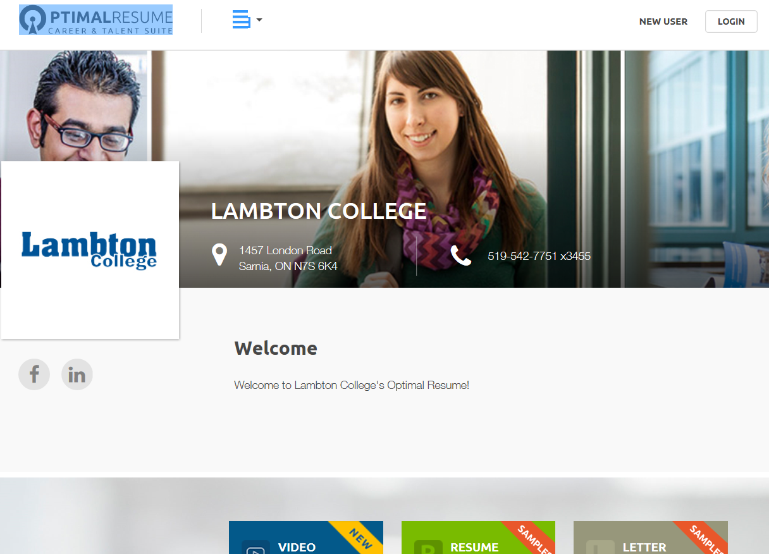
https://lambton.optimalresume.com/
*Create an Account Login using your Lambton College email

Slide 29
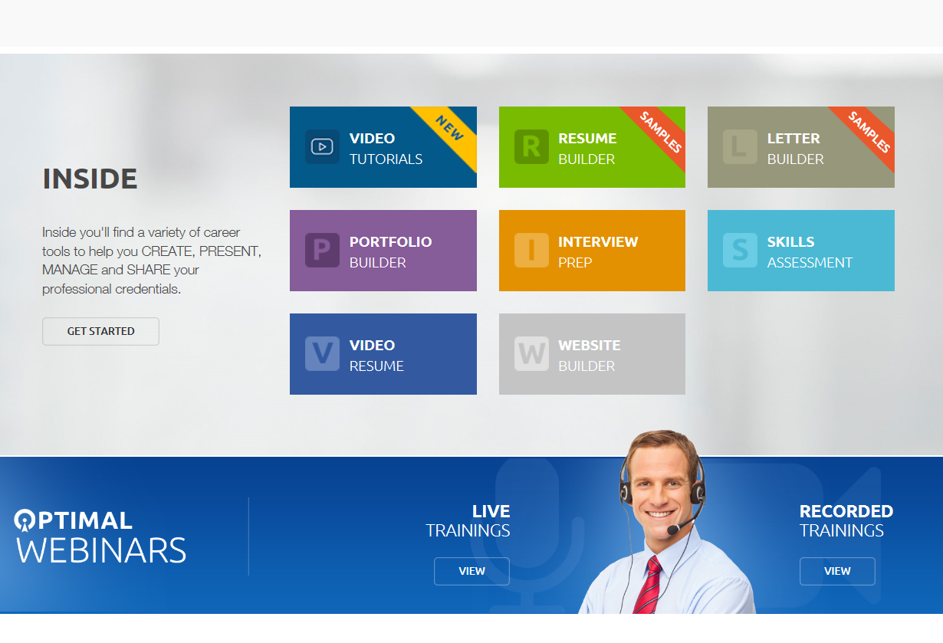

Slide 30
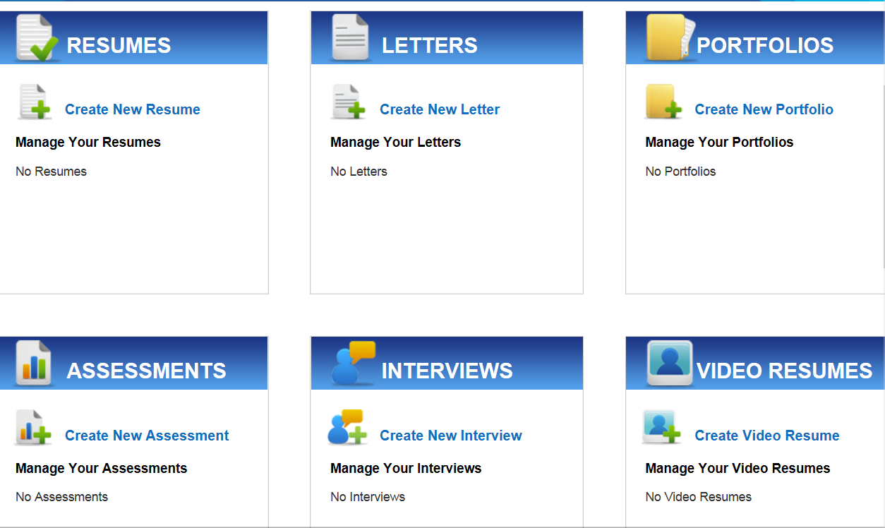

Slide 31
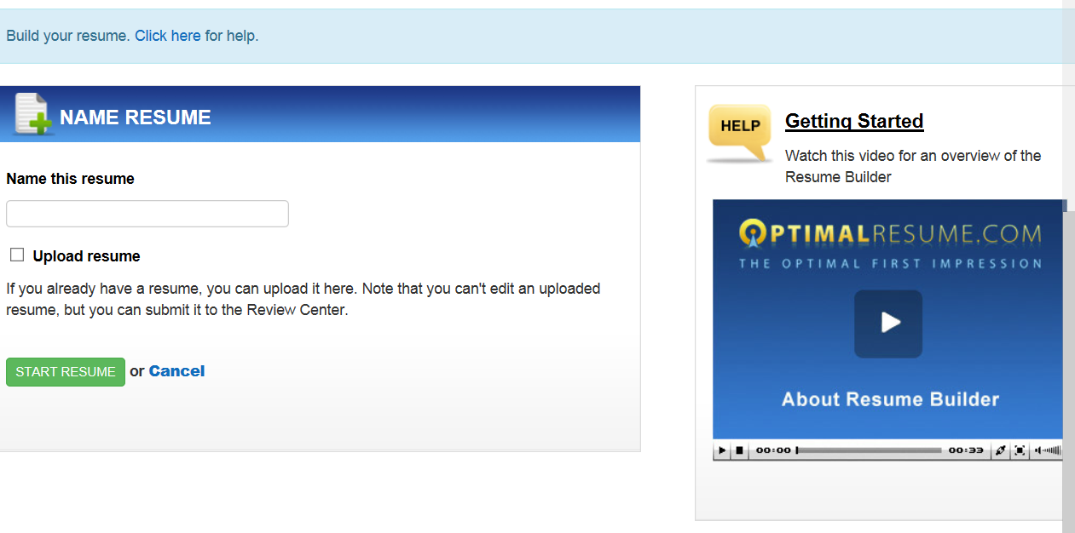

Slide 32
RESUME & COVER LETTER ASSIGNMENT
Due: Week #6 – October 10, 2018
Submit: Soft Copy by 11:59 pm October 10, 2018
Hard Copy by 12:45 pm October 11, 2018
Please refer to Moodle for sample and instructions.
Must choose one (1) job description from the instruction file - and target both resume & cover letter to it!
Notes:
Update to include relevant assignment due dates

Slide 33
Week #4 – Online Work
Read:
http://www.sheknows.com/living/articles/6465/a-good-rsum-versus-a-great-rsum
Optimal Resume: Submit One Sample of Poor Resume
Login and create an account
Watch the following video tutorials
The Optimal Resume Strategy
Top 10 Tips for Resume Formatting
Find an example of a poorly done resume (one that does not follow class instructions)– upload that to Moodle
Submit: Own Personal Resume Format (1st Draft)
Create a resume following Week #4’s guide & Sample provided. I will be looking for formatting – not accomplishment statements. Looking to see headings and how you create your sections, using lines to separate sections, etc.

